Slide 1


Prediksi Harga Bitcoin Menggunakan Transformer
Mengintegrasikan Harga, Sentimen, Tren, dan Volume dalam Analisis Deret Waktu Multivariat
Gilang Islamay Putra Djuharis
11190940000055

Slide 2
Revisi Revisi Revisi Revisi Revisi Revisi Revisi Revisi Revisi Revisi
01
02
03
Differencing Transformation
Baseline Model Explanation
04
More Clearance
Static Metadata Importance

Slide 3
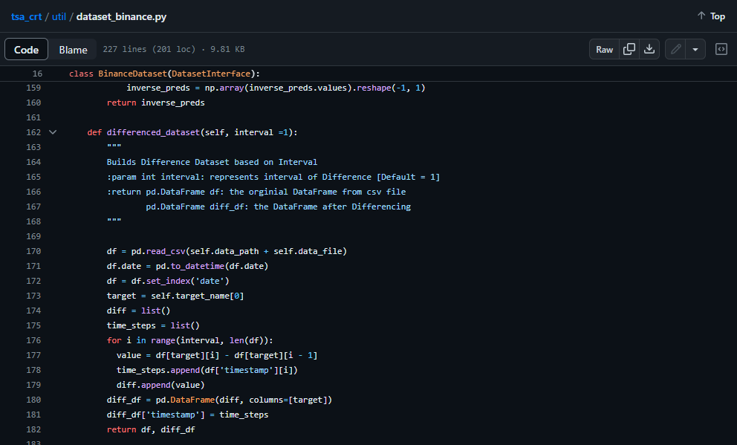
Differencing Transformation On Forecasting Cryptocurrency Prices: A Comparison of Machine Learning, Deep Learning, and Ensembles (Q1)

Slide 4
Differencing Transformation Only on Two Variable
Model | Moving Average |  |  | IQR
 | RMSE | MAE | MAPE | RMSE | MAE | MAPE
TFT | 0,0261 | 0,0177 | 3,0973 | 0,0463 | 0,0312 | 6,7257
TFT_{w/o} | 0,0263 | 0,0176 | 3,0737 | 0,0479 | 0,0316 | 6,9818
TCN | 0,0263 | 0,0175 | 3,0627 | 0,0477 | 0,0322 | 7,0084
TCN_{w/o} | 0,0262 | 0,0172 | 3,0166 | 0,048 | 0,0318 | 7,0042
GRU | 0,0262 | 0,0175 | 3,0764 | 0,0475 | 0,0316 | 6,9442
GRU_{w/o} | 0,0263 | 0,0175 | 3,0678 | 0,0479 | 0,0318 | 7,025
LSTM | 0,0262 | 0,0174 | 3,0532 | 0,0477 | 0,0314 | 6,9306
LSTM_{w/o} | 0,0264 | 0,0174 | 3,0469 | 0,0479 | 0,0317 | 7,0063

Slide 5
Differencing Transformation On All Variable (Except Static Metadata)
Model | Moving Average |  |  | IQR
 | RMSE | MAE | MAPE | RMSE | MAE | MAPE
TFT | 0,026 | 0,0175 | 3,0597 | 0,0476 | 0,0315 | 6,915
TFT_{w/o} | 0,0263 | 0,0174 | 3,045 | 0,0479 | 0,0319 | 7,0546
TCN | 0,0261 | 0,0173 | 3,0337 | 0,0478 | 0,0315 | 6,943
TCN_{w/o} | 0,0263 | 0,0176 | 3,0849 | 0,0478 | 0,0317 | 6,9939
GRU | 0,0264 | 0,0175 | 3,0644 | 0,0478 | 0,0325 | 7,1585
GRU_{w/o} | 0,0263 | 0,0175 | 3,0683 | 0,048 | 0,0317 | 6,9906
LSTM | 0,0263 | 0,0175 | 3,0588 | 0,0479 | 0,0319 | 7,0431
LSTM_{w/o} | 0,0263 | 0,0174 | 3,0422 | 0,048 | 0,0317 | 7,0035

Slide 6
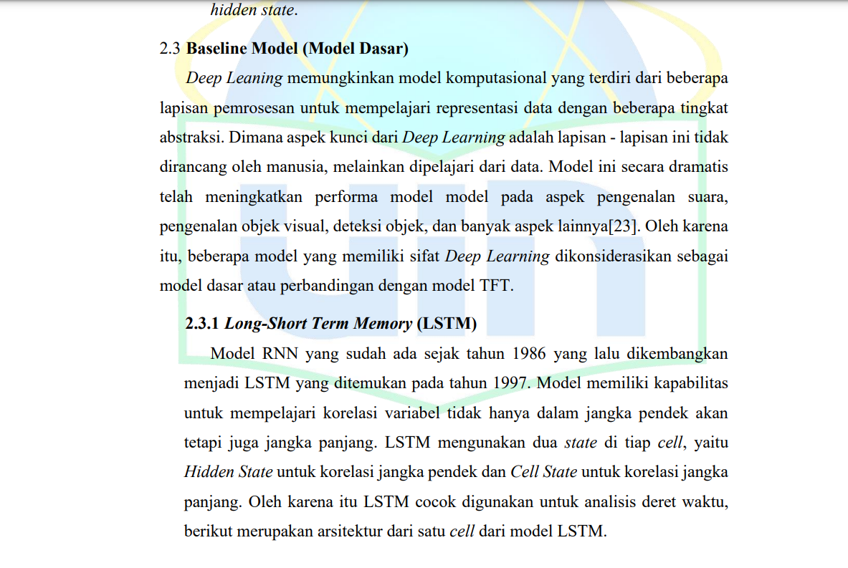
Baseline Model Explanation Long-Short Term Memory, Gated Recurrent Unit, Temporal Convolutional Network

Slide 7
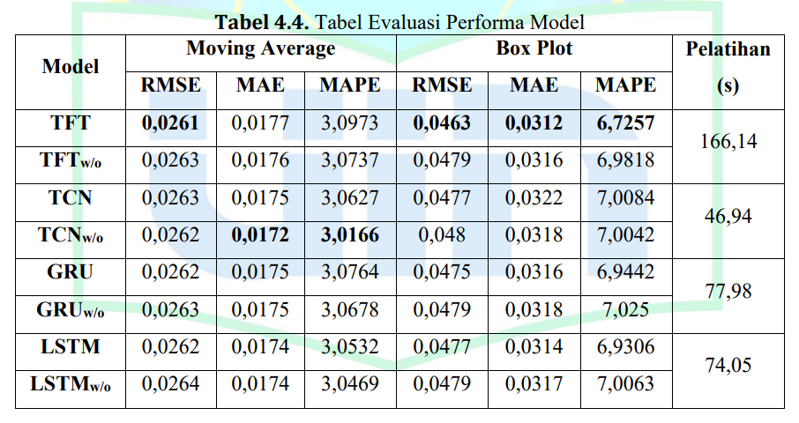
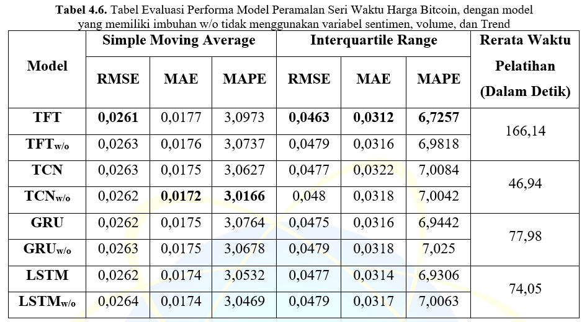
More Clear Before & After
After
Before

Slide 8
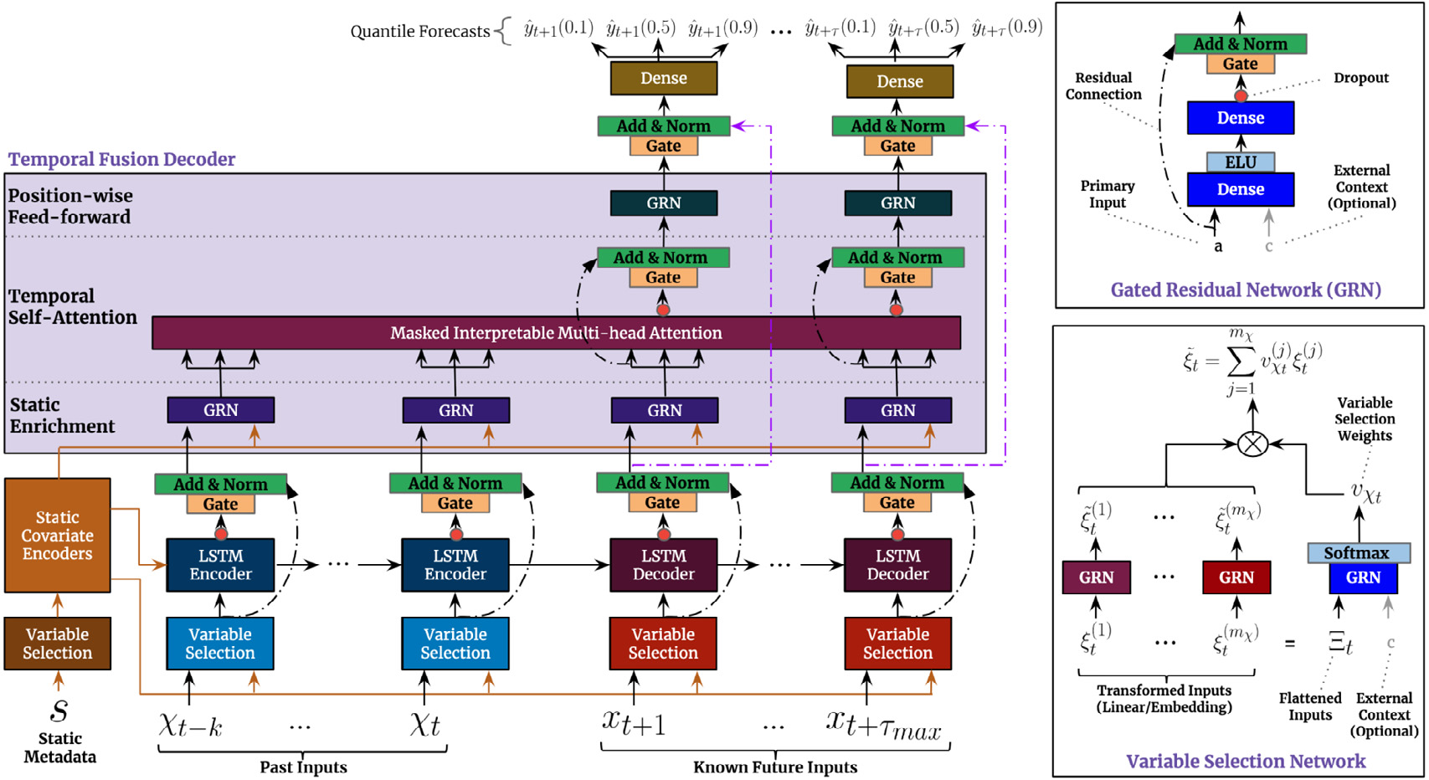
Static Metadata Importance What about it?
(Temporal Fusion Transformers for Interpretable Multi-horizon Time Series Forecasting, 2019)

Slide 9
Static Metadata Importance What about it?
Model | RMSE | MAE | MAPE
TFT dengan Kovariat Statis | 0,0261 | 0,0177 | 3,0973
TFT tanpa Kovariat Statis | 0,0263 | 0,0176 | 3,0937

Slide 10
BONUS!

Slide 11
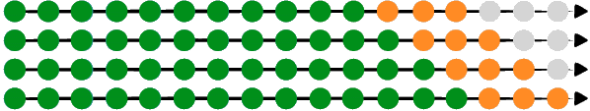
Cross-Validation Rolling-Origin Cross-Validation (ROCV)
(Evaluating short-Term forecasting of COVID-19 cases among different epidemiological models under a Bayesian framework, 2021)

Slide 12
Cross-Validation Rolling-Origin Cross-Validation (ROCV)
Fold | TFT | LSTM | TCN | GRU | TFT_{w/o} | LSTM_{w/o} | TCN_{w/o} | GRU_{w/o}
1 | 0,09466 | 0,09592 | 0,09656 | 0,09636 | 0,09653 | 0,09635 | 0,09601 | 0,0961
2 | 0,06329 | 0,0621 | 0,06089 | 0,06152 | 0,062 | 0,06134 | 0,06194 | 0,06254
3 | 0,02842 | 0,02893 | 0,02956 | 0,0295 | 0,02949 | 0,02954 | 0,02936 | 0,02929
4 | 0,0235 | 0,02412 | 0,02346 | 0,02327 | 0,02352 | 0,0231 | 0,02352 | 0,02379
mean | 0,05254 | 0,05307 | 0,05279 | 0,05268 | 0,05298 | 0,05259 | 0,05309 | 0,05293
Variance | 0,00108 | 0,00098 | 0,00112 | 0,00112 | 0,0011 | 0,00106 | 0,00109 | 0,00107

Slide 13
Thank You
“Barang siapa yang menjadikan mudah urusan orang lain, pasti Allah akan memudahkannya di dunia dan di akhirat.” (HR. Muslim)

